Slide 1
Measuring the Loss of Wealth
in Asheville
Group 4:
Xander Smead, Yicheng Wang, Daniel Rong, Zhaojie Yin, Anna Kafrune

Slide 2
What is the Main Goal of your Project
We will be focusing on the urban renewal of Asheville that occurred during the 60’s. More specifically, the reparations that still need to be paid to the affected families.
The main goal of our project is to account for the inflation in property value over the last 50 years so that if/when reparations are being paid it would be for the amount that the properties would be worth today.
These values will also highlight just how much was taken from these families back then. Owning property is a way for families to maintain and pass down wealth.

Slide 3
Who is the Target Audience
A former resident who lost his house (who doesn’t know what happened)
Legal heir of a former owner of a parcel that was acquired because of the owner’s death (who is not aware of what happened)
Citizens of Asheville
Reparation committees (HACA)
Researchers who are interested in the measuring the loss of wealth in Asheville
Urban construction department
Notes:
Former resident who lost his house and doesn’t know what happened (the group of people who live in the place originally but were forced to leave and have no idea of what’s going on with their former apt. They get very little compensation).
Children of a former owner of a parcel acquired because of owner’s death and they are not aware of what happened. (They were not present at the property during the possession. )

Slide 4
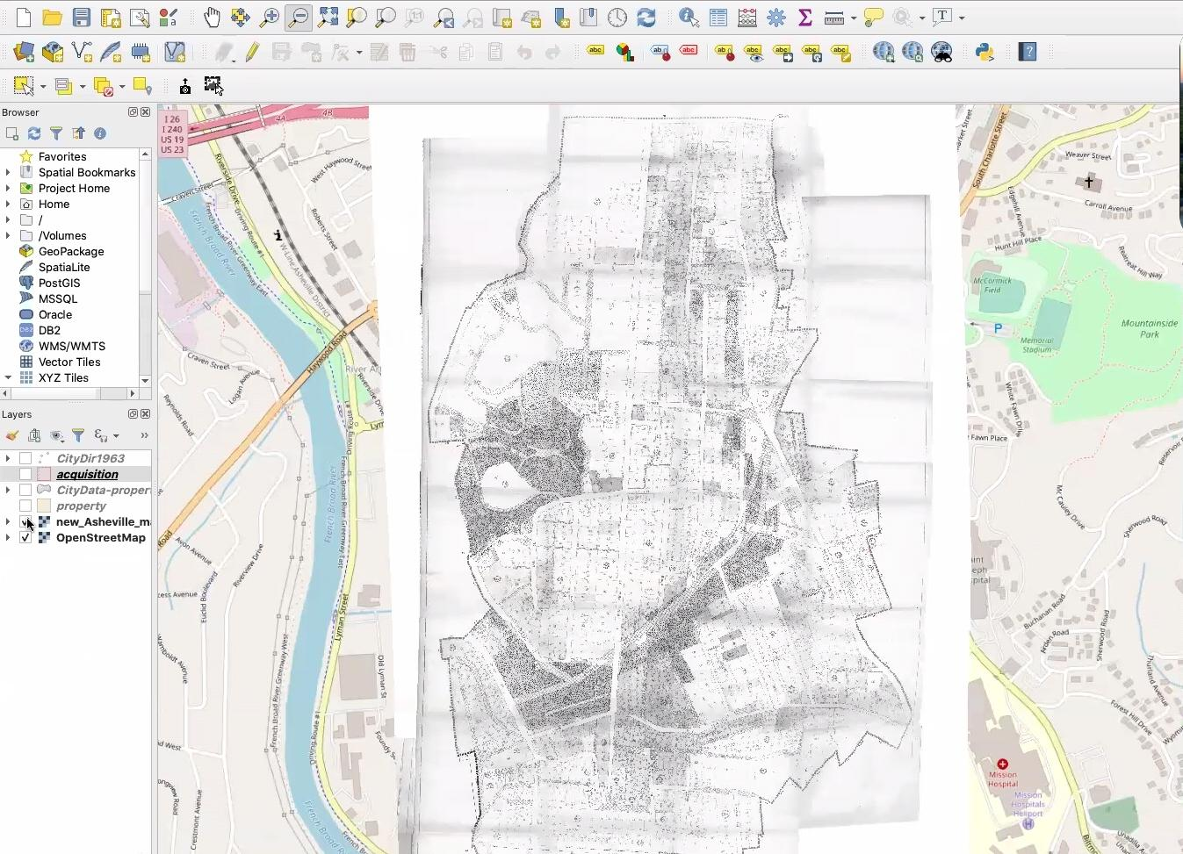
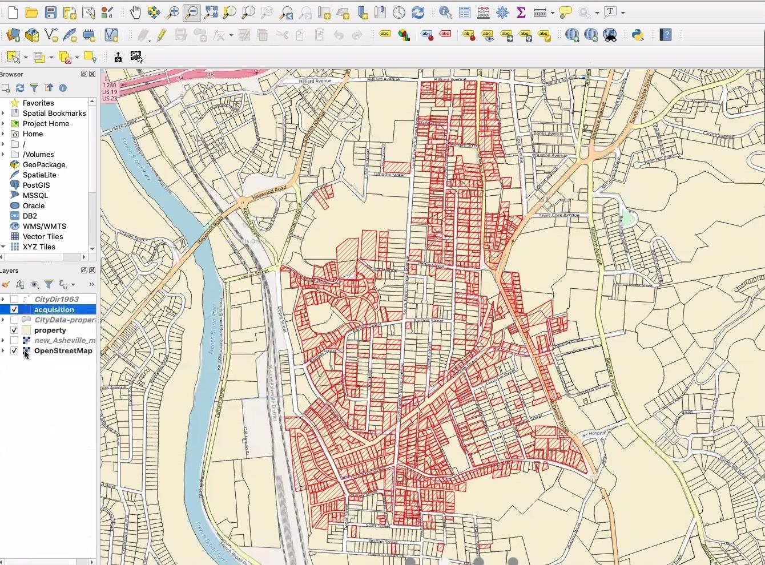
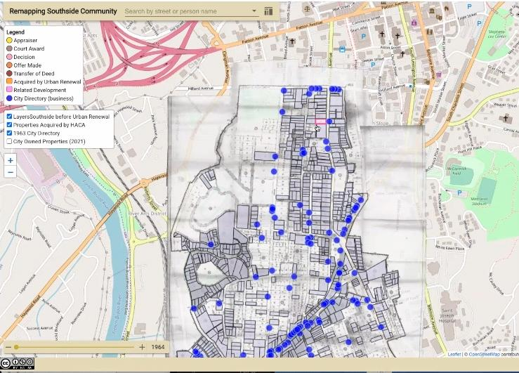
Information to Use
Use QGIS (software) to view and modify the layers of Asheville’s map to check the change in property area
Notes:
Use QGIS to view and modify the layers of the map to check the change in property area (e.g. if some were combined into one single property) and later which of these old and newly formed properties are owned by the government. If not all properties are owned by the government today, then when did they stop being owned by it.

Slide 5
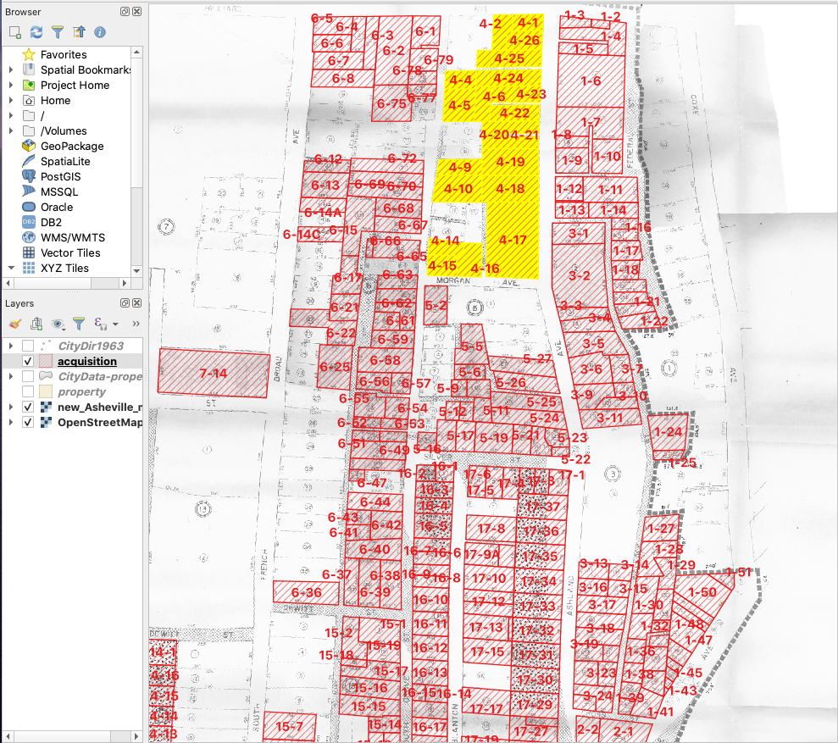
Information to Use
Start with a single block of properties
Block 4
Notes:
We will start with a single block of properties. Depending on how in-depth we go on our project and the time we have, we can either keep working with one block or apply what we developed to more blocks.

Slide 6
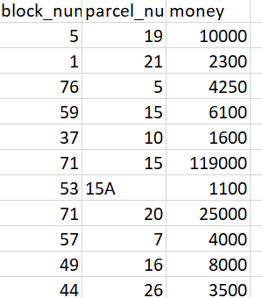
Information to Use
Use dataset values
Start with using the existing calculator on https://measuringworth.com/
Will provide an expected value for each property’s current worth in today’s dollar for the initial analysis of the events

Slide 7
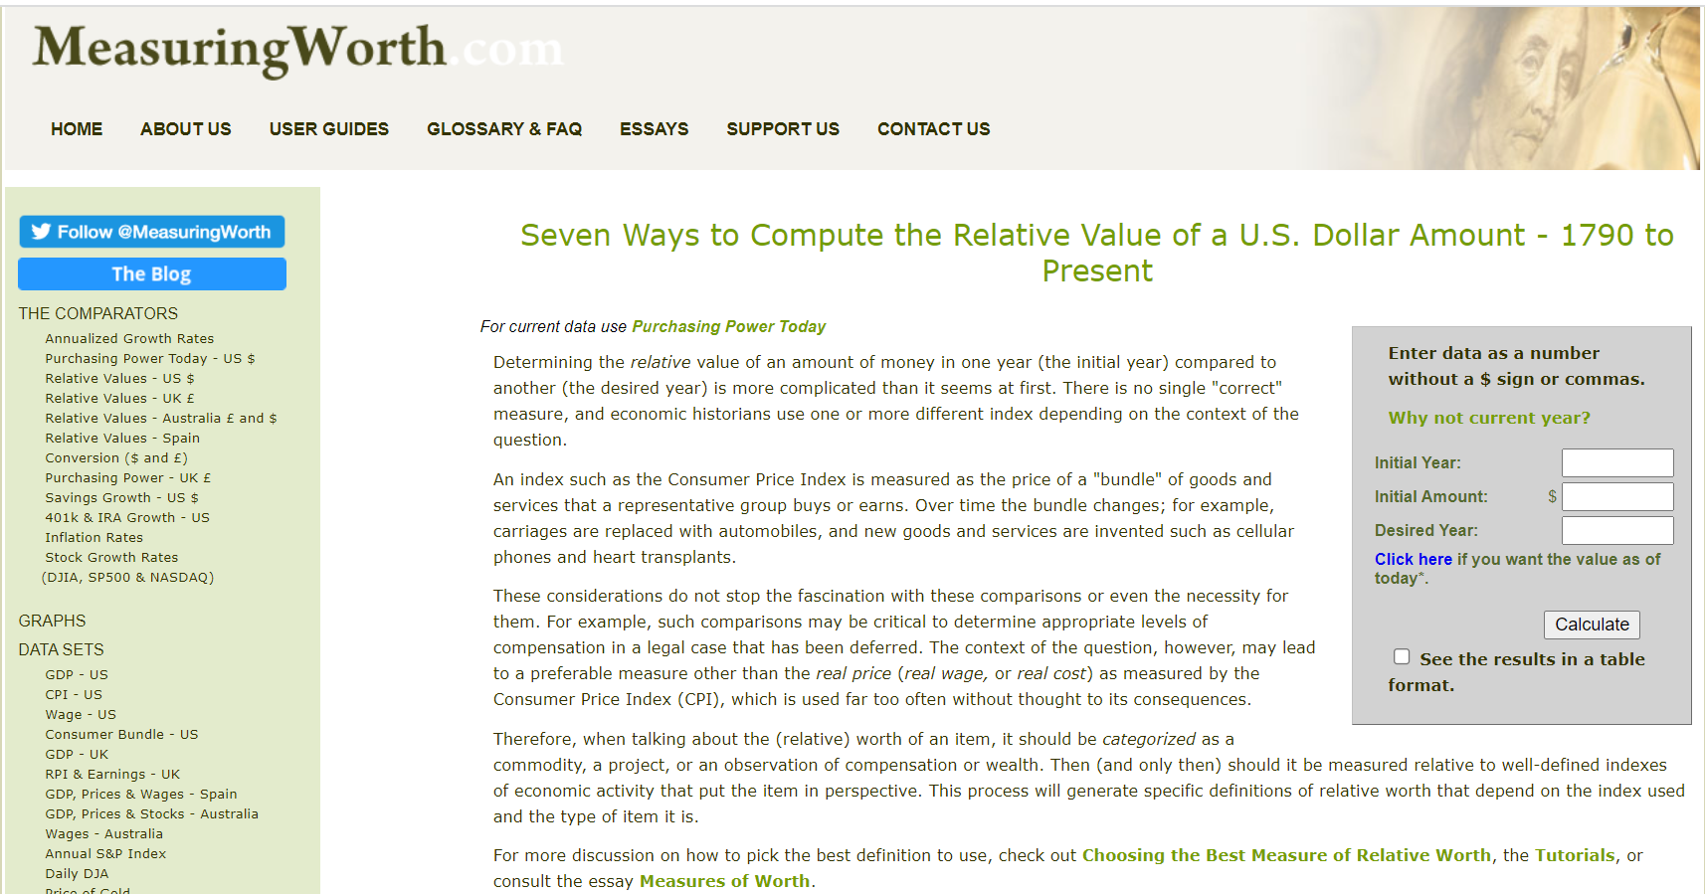
Notes:
This feature of the website lets us compute the value of a dollar amount from a certain year to the present value by inputting the initial year, amount, and desired year on the right side of the screen

Slide 8
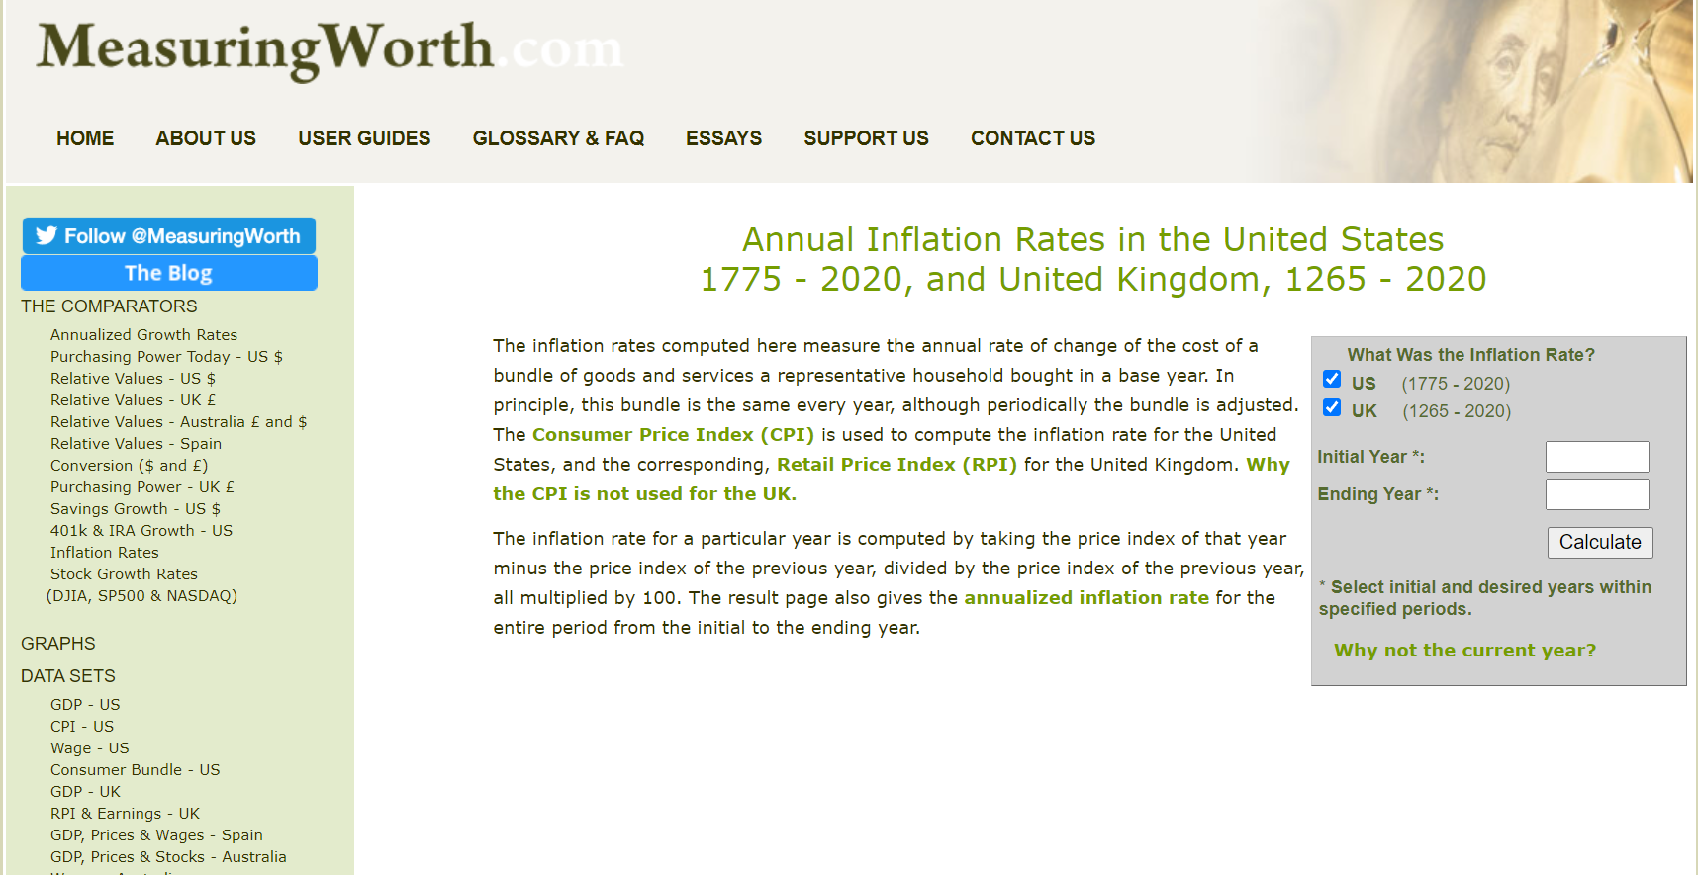
Notes:
This feature of the website lets us compute the inflation rates in a range of years by inputting the initial year and the final year on the right side of the screen

Slide 9
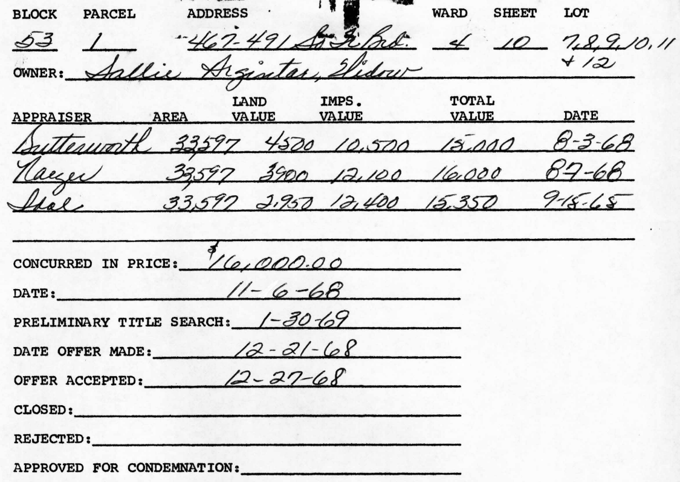
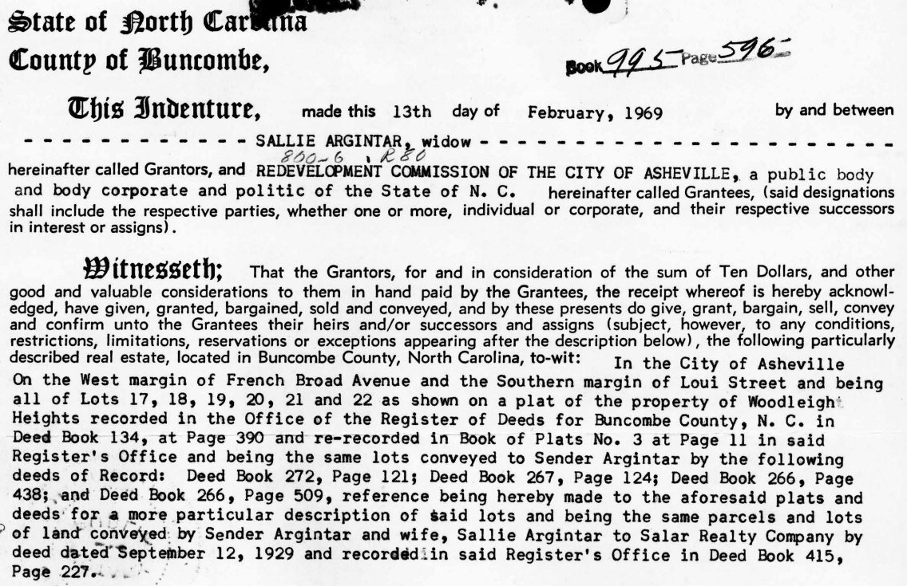
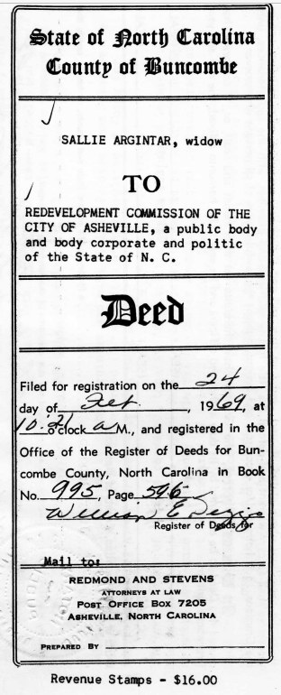
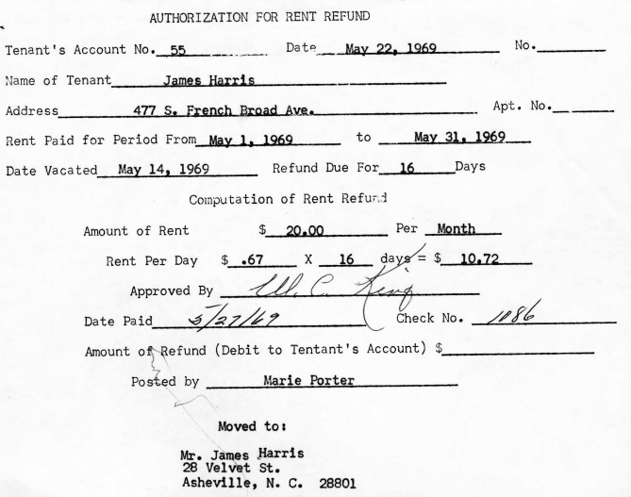
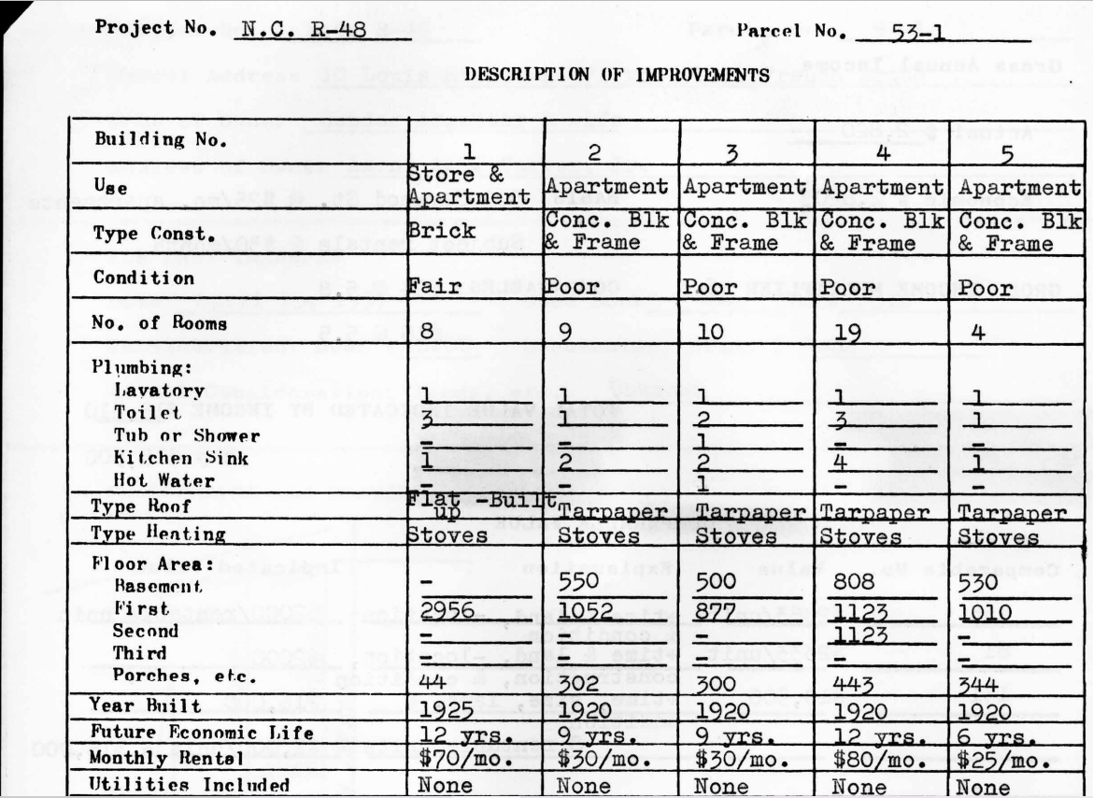
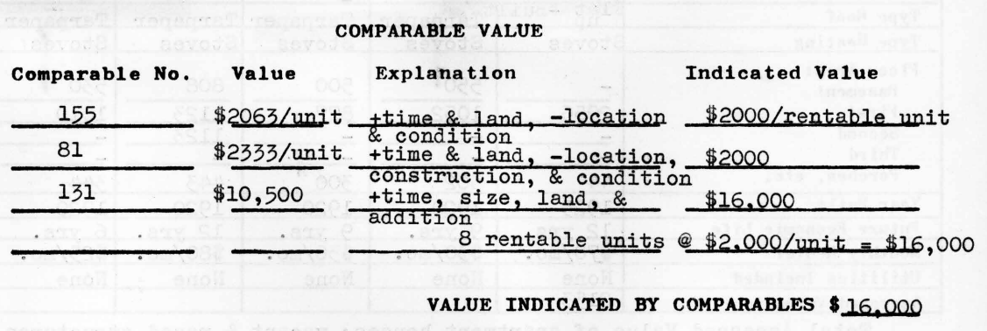
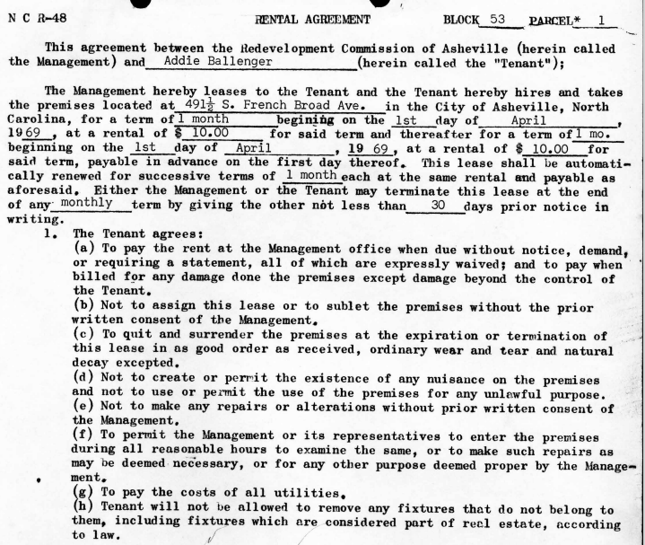
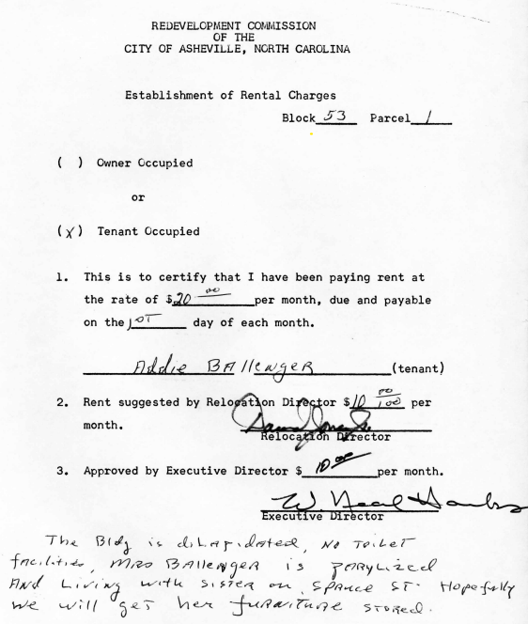
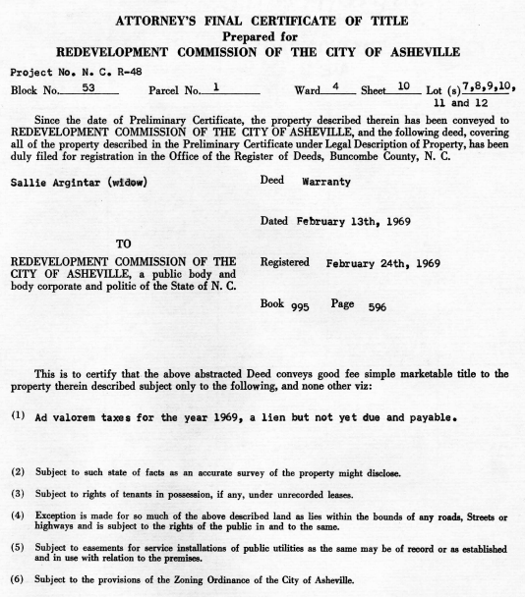
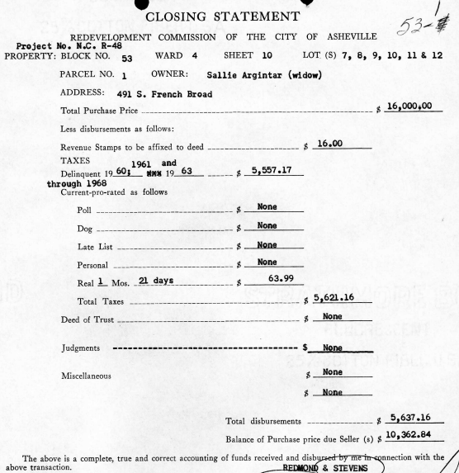
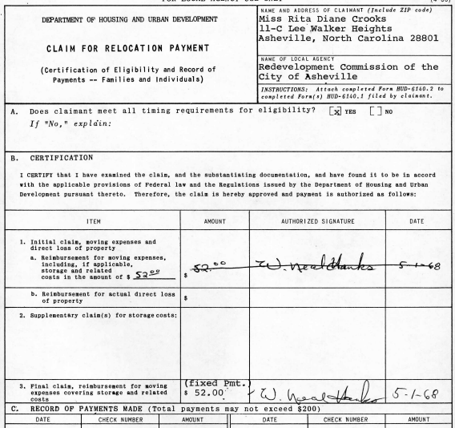
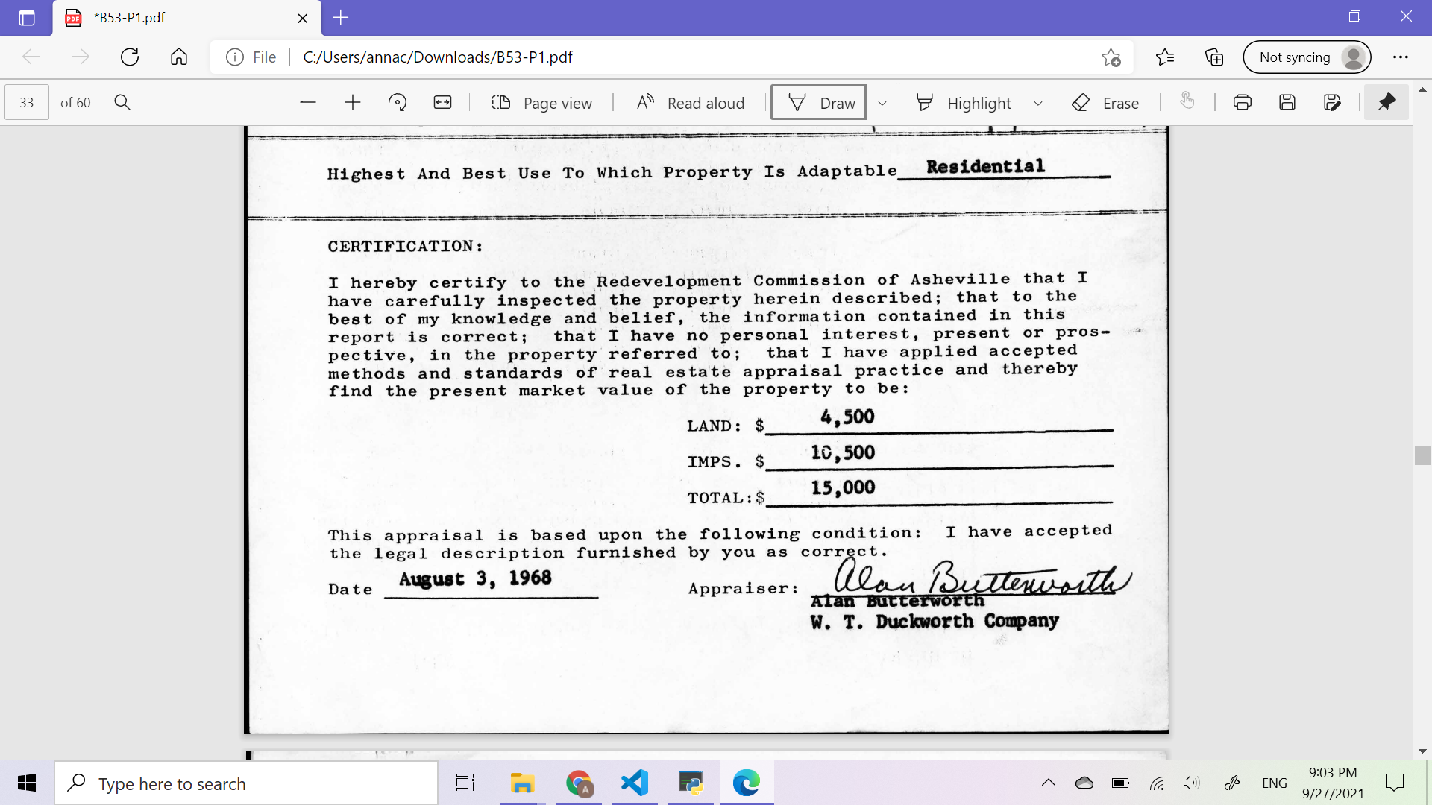
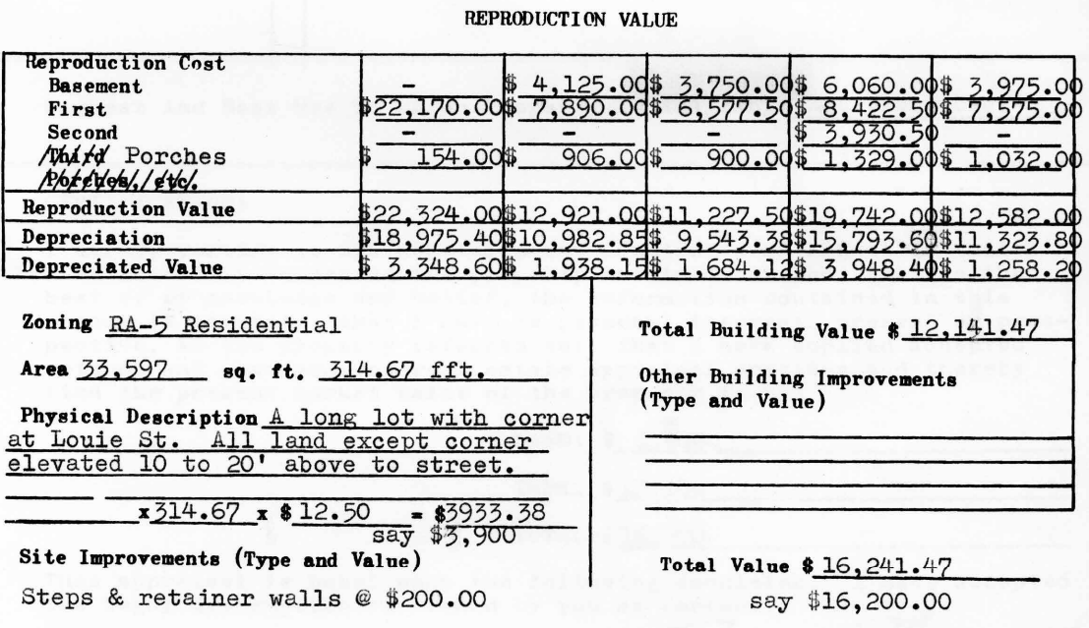
Information to Use
The acquisition collection, containing digitized documents from the properties
Register of Deeds from the Buncombe County website
Retrieve more information on the properties

Slide 10
Putting this Information Together
Based on the possibilities of calculation methods and the available data, we develop and implement our own calculator.
Will, potentially, provide more precise results for the current worth of the properties.
Calculating the current worth of the properties:
Property depreciation
Inflation
Combine all the information and data we had and discovered to write a jupyter notebook telling the audience about Asheville’s urban renewal and the its effect on generational wealth
Notes:
Using all this information, we hope to be able to develop our own calculator for determining the value of the properties if they were still around today. As stated before, while we do have data on how much properties were "purchased" for, this is not enough as we need to account for property depreciation, inflation, and many other factors. Once this calculator has been made, we plan to combine all the information we've gathered to write a jupyter notebook to present to Asheville's local government.

Slide 11
Potential Outcomes of Our Project?
A jupyter notebook that illustrate the financial loss of Asheville residents in terms of property value inflation in the past 50 years with storytelling
Embedded bar charts and scatter plots --- bar charts for highlighting the value differences and scatter plots for the trend of properties’ value inflation visualization
A calculator to measure the formal Asheville properties’ value nowadays
Raising the awareness of the negative impact caused by Asheville Urban Renewal and pushing accountability investigation, thereby promoting legislation to make reparation available to Asheville residents.

